Slide 1
Autonomous Car Lane AND OBJECT INTERSACTION DETECTION
Student: Orian Dabod 308337062
https://github.com/orianhit/autonomousCar

Slide 2
agenda
Basic of OpenCV
How OpenCV relates to autonomous vehicle
Lane detection logic and implementation
Object detection & intersection logic and implementation
Why you NEED this tech your car

Slide 3
Basic of OpenCV
OpenCV (Open Source Computer Vision Library) is a library of programming functions mainly for real-time computer vision
OpenCV project was initially an Intel Research initiative to advance CPU-intensive applications, part of a series of projects including real-time ray tracing and 3D display walls
Goals:
Open but also optimized code for basic vision infrastructure
Disseminate vision knowledge
portable, performance-optimized code available for free

Slide 4
How OpenCV relates to autonomous vehicle
Object Detection
One of the most crucial tasks in self-driving cars is detecting and tracking objects on the road, such as pedestrians, other cars, and traffic signs. OpenCV provides powerful tools for object detection.
Lane Detection
OpenCV is frequently used for lane detection in self-driving cars. By analyzing video streams from cameras mounted on the car, OpenCV algorithms can detect lane markings and determine the vehicle's position within the lane.

Slide 5
How OpenCV relates to autonomous vehicle
Image Processing
Image processing is an essential part of self-driving car systems, and OpenCV provides a wealth of image processing tools, including filtering, thresholding, and edge detection
3D Reconstruction
OpenCV can be used to create 3D maps of the environment around a self-driving car. By using stereo camera systems or LIDAR sensors, OpenCV algorithms can create a 3D point cloud of the surrounding area

Slide 6
Lane detection logic and implementation
We want to extract the current lane the car is currently on
Should switch if the car is moving to another lane
One option is to represent it by 2 lines
Data was needed so I contacted some datasets owners and searched the web

Slide 7

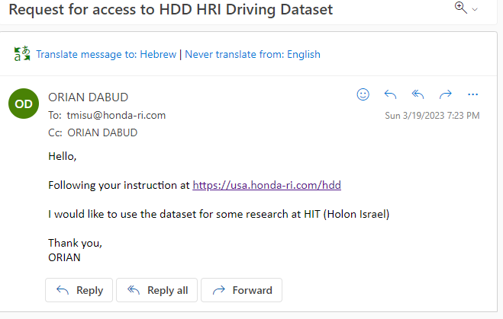
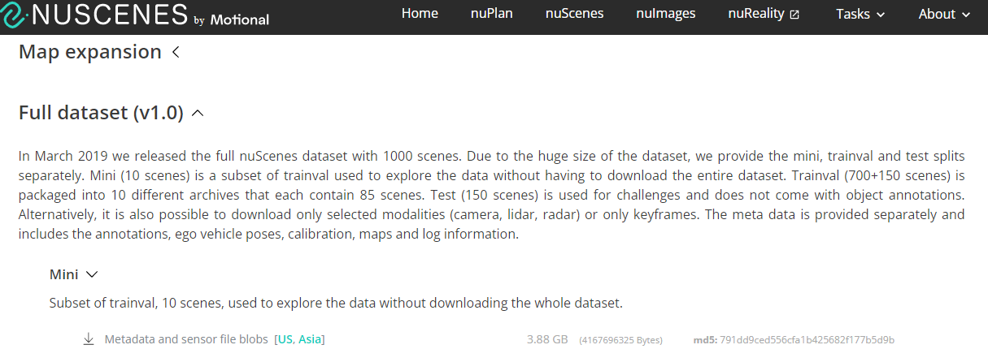

Slide 8
Lane detection logic and implementation
Manipulate the image
Color remove
Add blur
Use canny (popular technique for edge detection developed by John Canny in 1986)
Crop region of interest (using polygon)

Slide 9
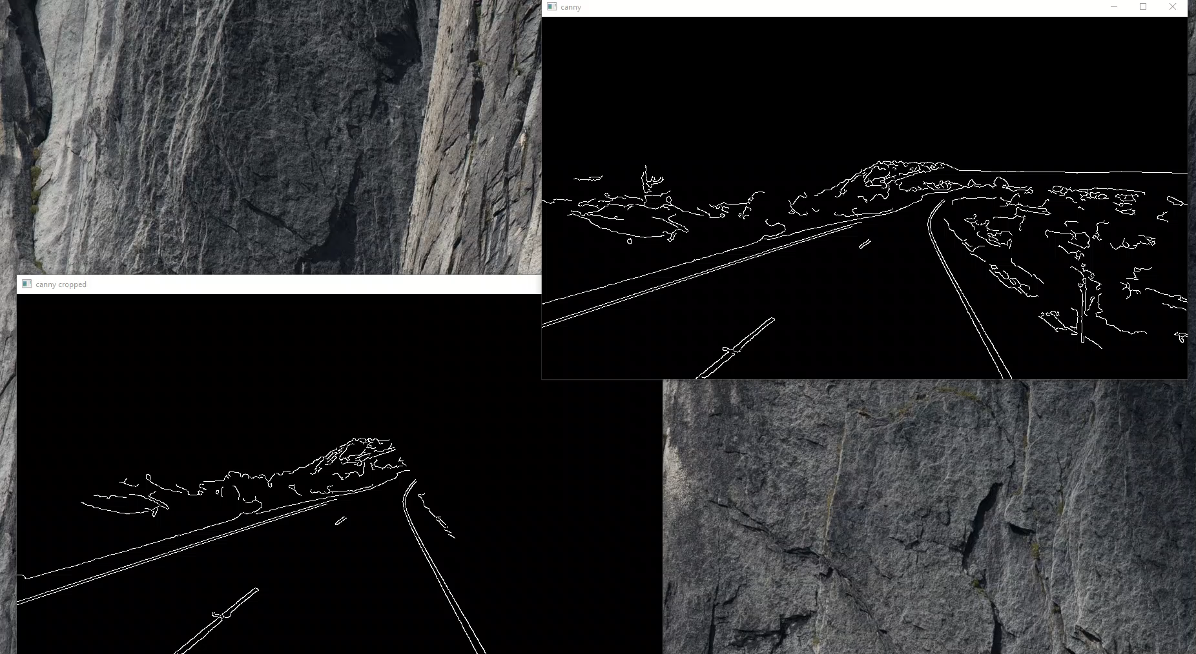
Lane detection logic and implementation

Slide 10
Lane detection logic and implementation
Find lines
Use hough lines (feature extraction technique to detect simple shapes such as lines and circles in an image. proposed by Paul Hough in 1962)
Use only semi horizontal lines (which pass slop threshold)
averaging slop of 2 lines

Slide 11
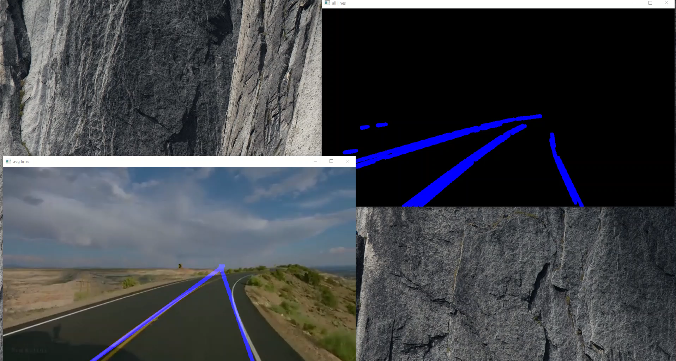
Lane detection logic and implementation

Slide 12
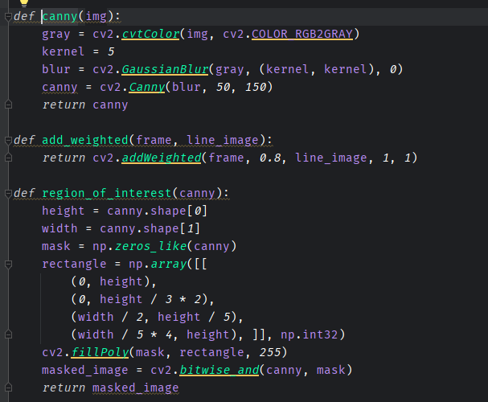
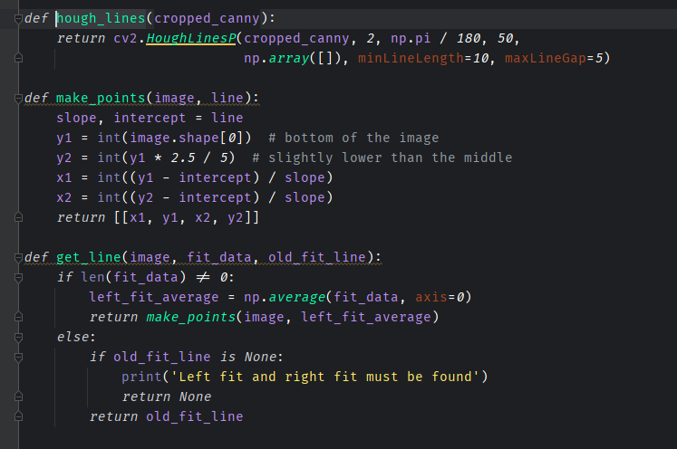
Lane detection logic and implementation

Slide 13
Object detection & intersection logic and implementation
Moving objects can be detected using diff between 2 following images
We will use localization (not segmentation) due to high performance
When moving objects enters our line, (aka there is intersection between line and the object), we want to prevent collision

Slide 14
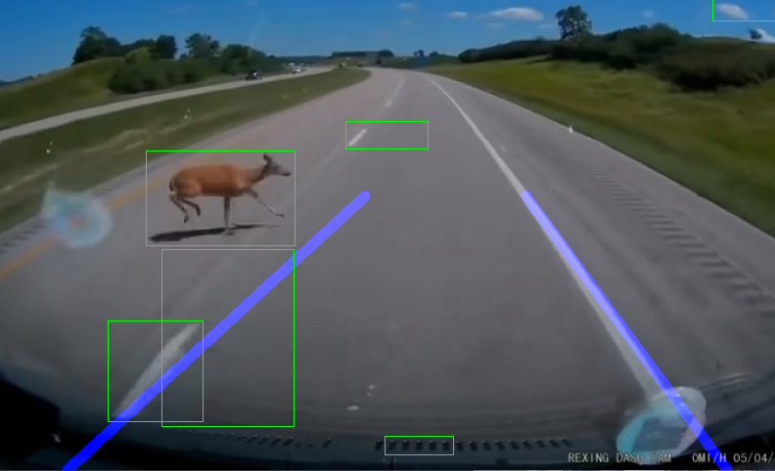
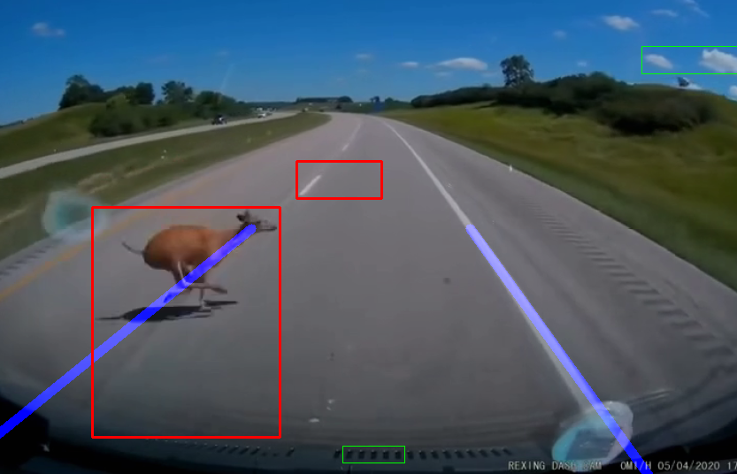
Object detection & intersection logic and implementation

Slide 15
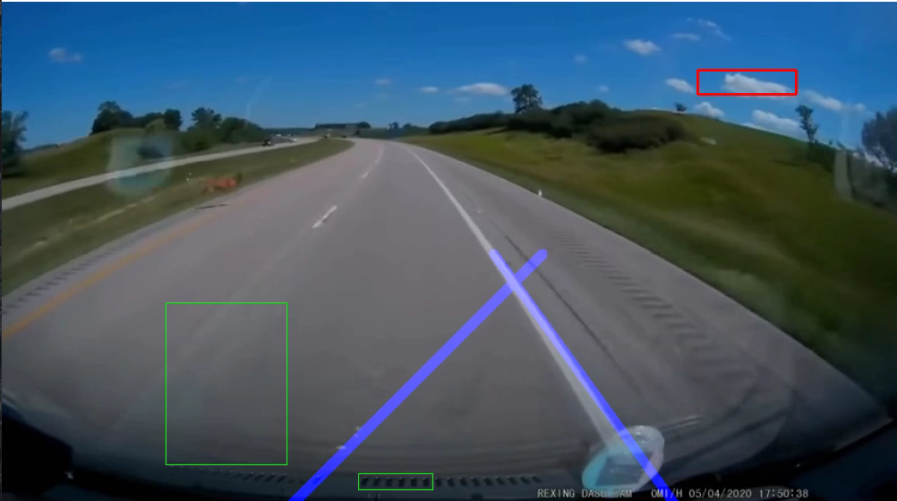
Object detection & intersection logic and implementation

Slide 16
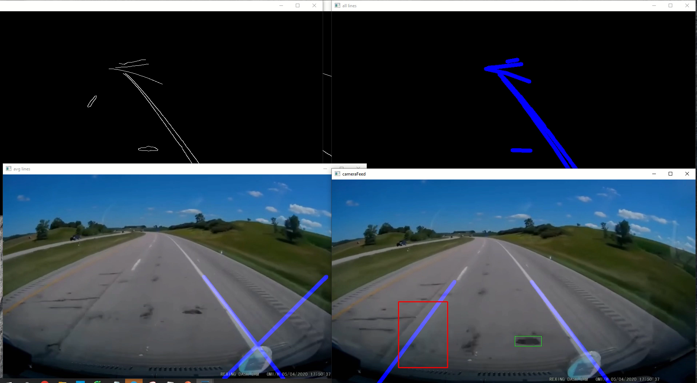

Slide 17
Conclusion (Why you NEED this in your car)
Using OpenCV is Cheap, both in terms of hardware and software
OpenCV and AI in general are essential for autonomous vehicles
Lane detection may need some adjustments depends on your camera location
Using this cheap solution you WILL prevent the next accident

